Slide 1

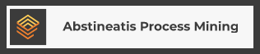

Abstineatis Process Mining
Business Plan

Slide 2
What is process mining?
Operations
Often tracked or hosted on IT platforms.
Transparent and accurate analytics
Process Mining
Algorithms used to analyse the performance of real world processes.

Slide 3
The Business
Value Proposition
Hardware Consulting and vending
Software Supply
Companies looking to upgrade their operations or business processes
Process mining software to improve visibility over processes
Training
Train analysts in the use of software

Slide 4

Demand vs Supply
Suppliers can not keep up with demand
Market Concentration
300%
Concentrated in Europe and North America, potential for expansion in the third world
Barrier to Entry
$160 mil.
Process mining as unknown concept. Introducing the technology to potential clients takes priority.
Gartner
2018 Estimations for market size
The Market

Slide 5
The Future
5 Years
Content
Here
3 Years
1 Year
Planning for Africa expansion
3 Months
Leading consulting firm in South African market
35 Clients
Business Establishment Completed
Business Establishment
18 Clients
6 Clients
Client 1

Slide 6
The Competitors
USA
Europe
01
02
03
Celonis
UiPath
Minit
Intelligent Business cloud to conduct business. Large company with a lot of available resources.
Enable users to use existing data from ERP and CRM software. Offer online and offline solutions.
Offer solutions for average hardware and looking at expanding beyond USA, Europe and Asia.
Presented by: Hannes Piek

Slide 7
Risk Mitigation Strategies
Overpriced
Asking too much for the target market.
Insufficient Skills
Developing countries without proper education may lead to insufficient skills
Insufficient Equipment
Importing equipment and processes not having data sampling capabilities
Over-Competitive market
Expanding competition
Presented by: Hannes Piek

Slide 8
Cash to cash cycle.
01
Start-up capital
The start-up cost estimation for this is R 873 164
15% safety capital.
Investment needed rounded to R 1 000 000
Costing
02
Consultation @ R5 000
Custom software @ R20 000
Monthly subscription @ R3 500.
03
Development
1 month
Launch and logistics
04
3 months
05
Cash to Cash
4 months

Slide 9

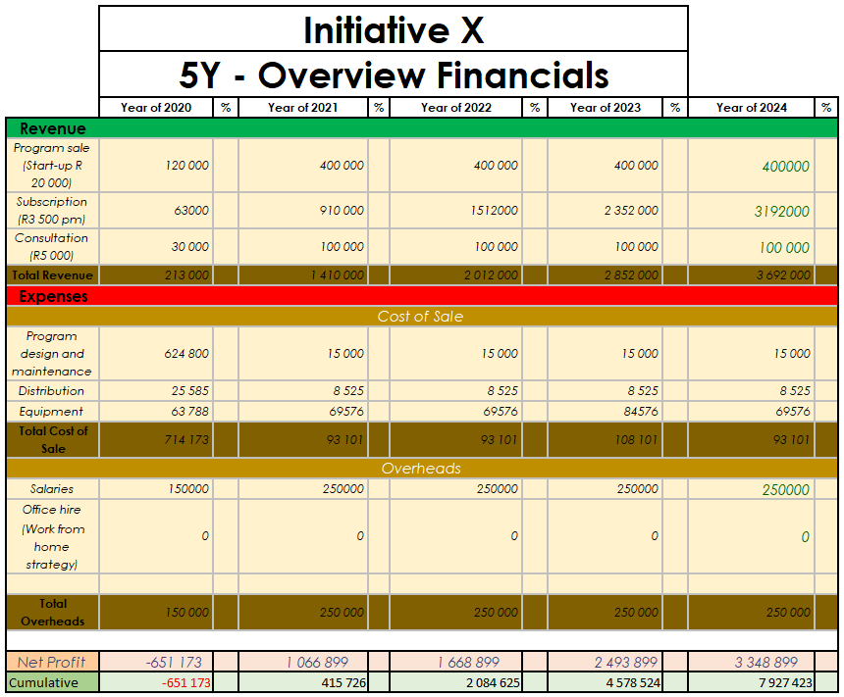
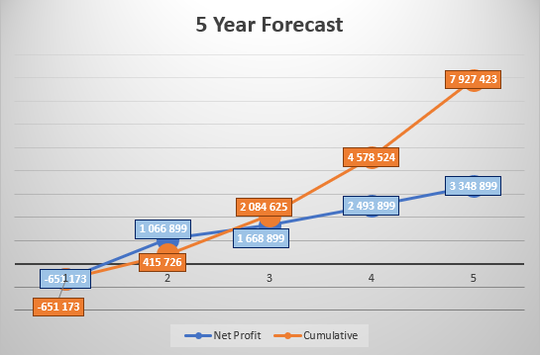
Five year forecast.
Abstineatis

Slide 10

Partner type
Profit share
Silent equity investor.
Share based investment.
.
The partner is then given 15% of all positive profits per financial year, with pay-off on the Start-up capital equity.
Buy back
Partner duties
Company retains right to buy out shares at market price after five years from start-up.
Shares are bought at current market value.
Investor is a silent partner.
Investor will not partake in decision making.
Investment
Opportunity.

